Slide 1
MapReduce 2.0/YARN
Jay Urbain, PhD

Slide 2
Limits of MapReduce 1.0
Its actually ~10 years old
Limits in the API
Only batch processing, not interactive
People want interactivity like RDBMS queries
Coding MapReduce is complex, not enough developers
Jobs don’t fit all big data business scenarios
Missing enterprise features, security, etc.

Slide 3
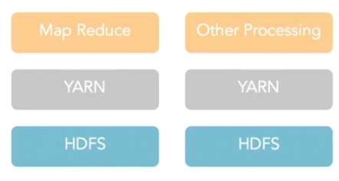
MapReduce 2.0 YARN Yet Another Resource Negotiator
YARN adds abstraction layer between MapReduce and HDFS
Allows for other processing to occur on top of HDFS file system
As volume of data increases, they want cheap HDFS storage, but better processing
Spark, Impala

Slide 4
MapReduce 2.0
Adds YARN
Supports multiple libraries
MapReduce not required
Splits the existing JobTracker’s roles
Resource management
Job life-cycle management
Better scalability
Batch or real-time + interactive processing
Adds enterprise features, admin, security

Slide 5
MapReduce 2.0
Execution flexibility/control
Mapper/Reducer configure method takes params
Tools/GenericOptionsParser takes HCI options
Reports can use app-specific info
Distribute read only data for jobs

Slide 6
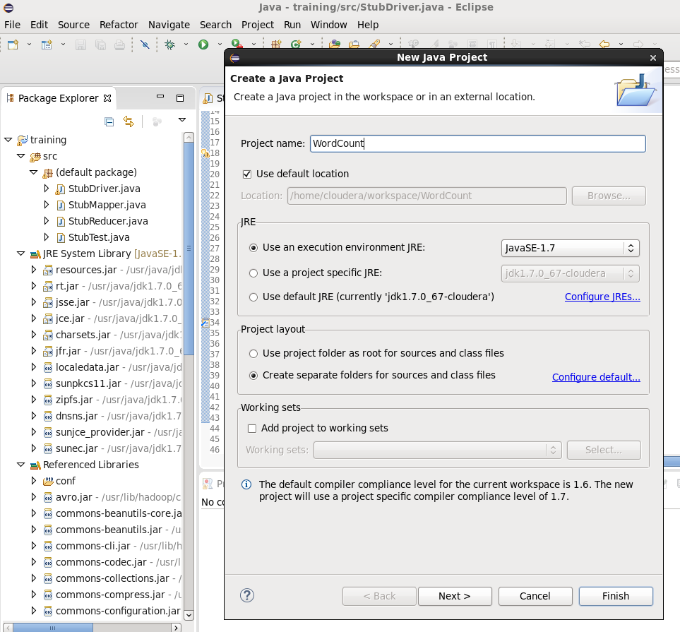
Coding MapReduce 2.0 In Eclipse: create a new JavaProject “WordCount”

Slide 7
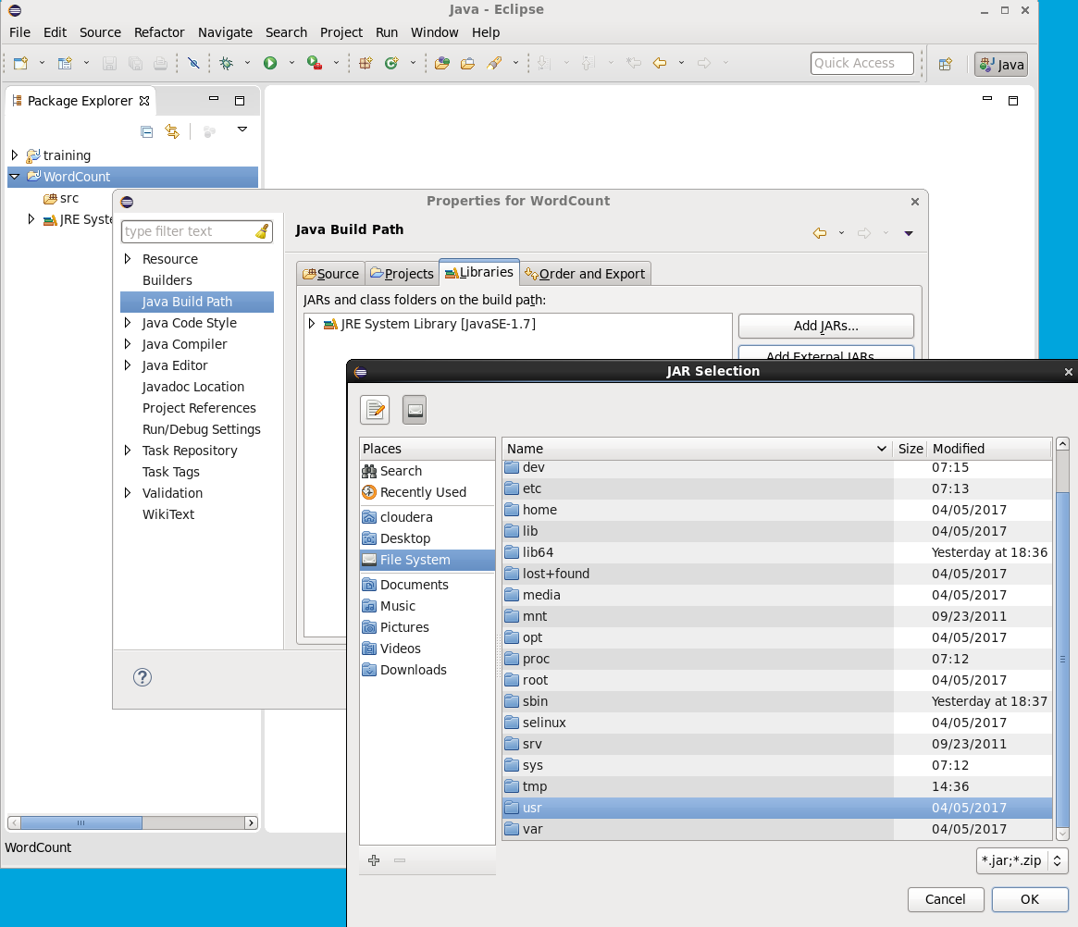
Add external libraries Right-mouse project -> Java Build Path -> Add External Jar -> File System -> usr

Slide 8
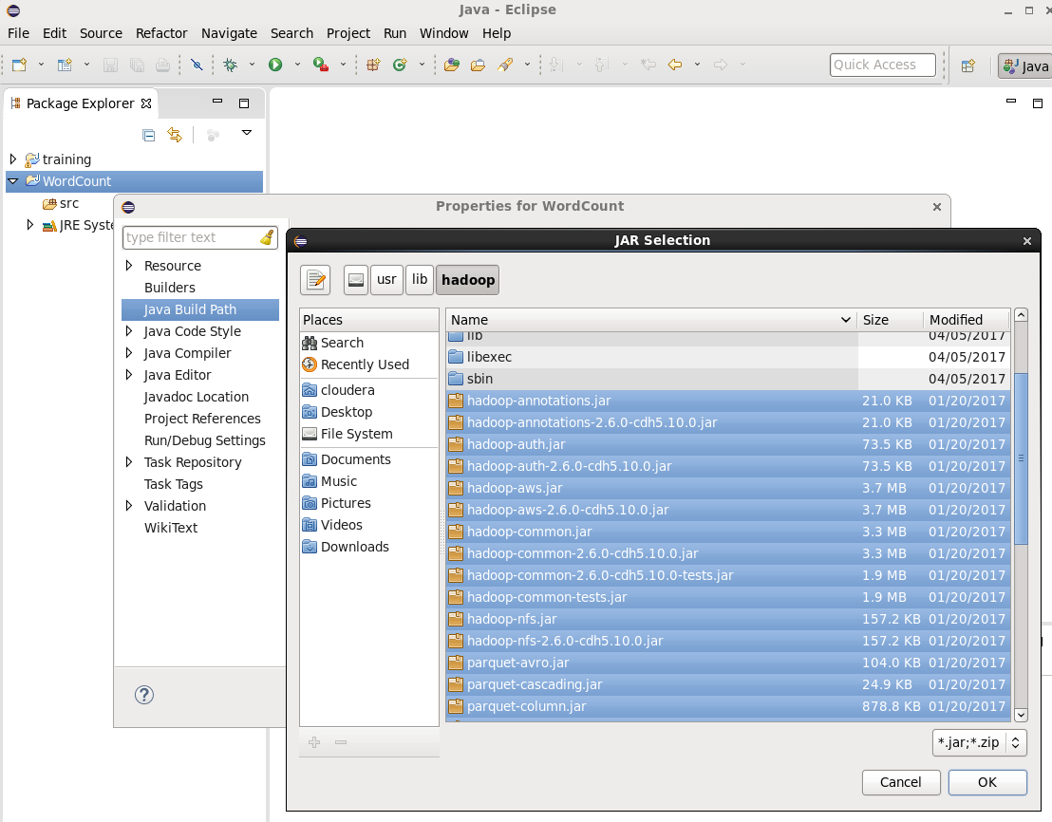
Add external libraries (continued) Right-mouse project -> Java Build Path -> Add External Jar -> File System -> usr -> lib -> hadoop Select all jar files

Slide 9
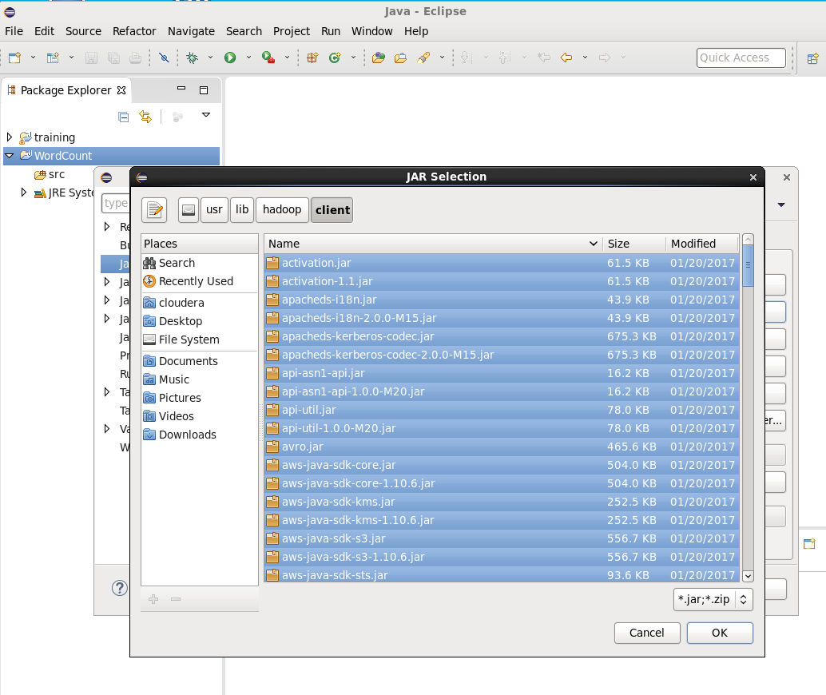
Repeat for client Java Build Path -> Add External Jar -> File System -> usr -> lib -> hadoop -> client -> Select all jar files

Slide 10
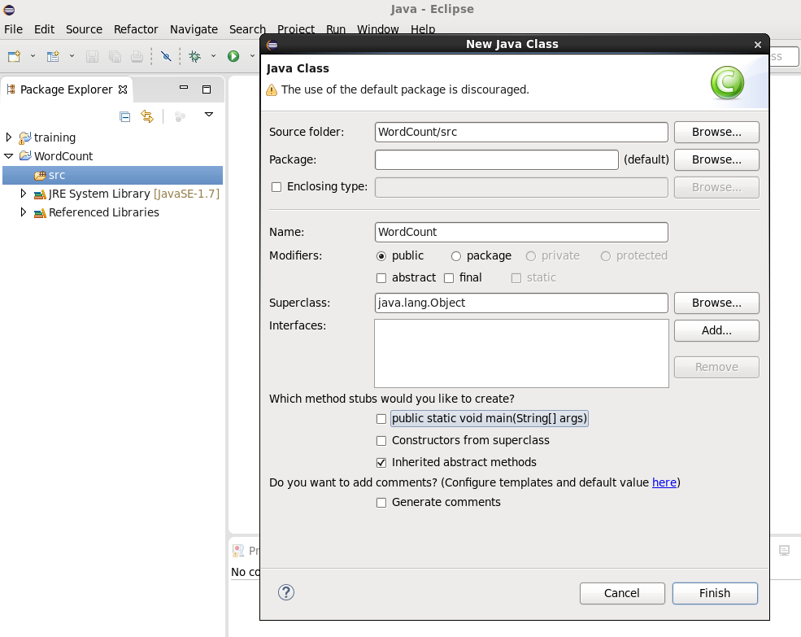
Create a org.myorg package Create a Java WordCount class within the org.myorg package

Slide 11
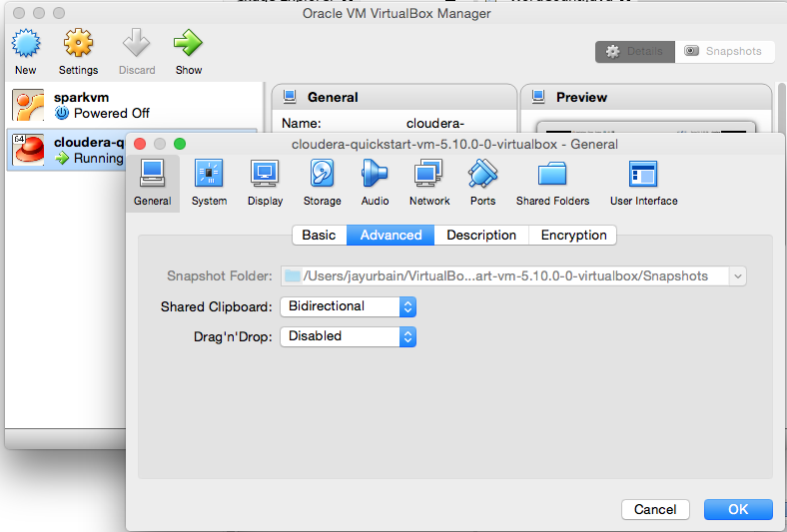
Oracle VM Settings -> Advanced Settings

Slide 12
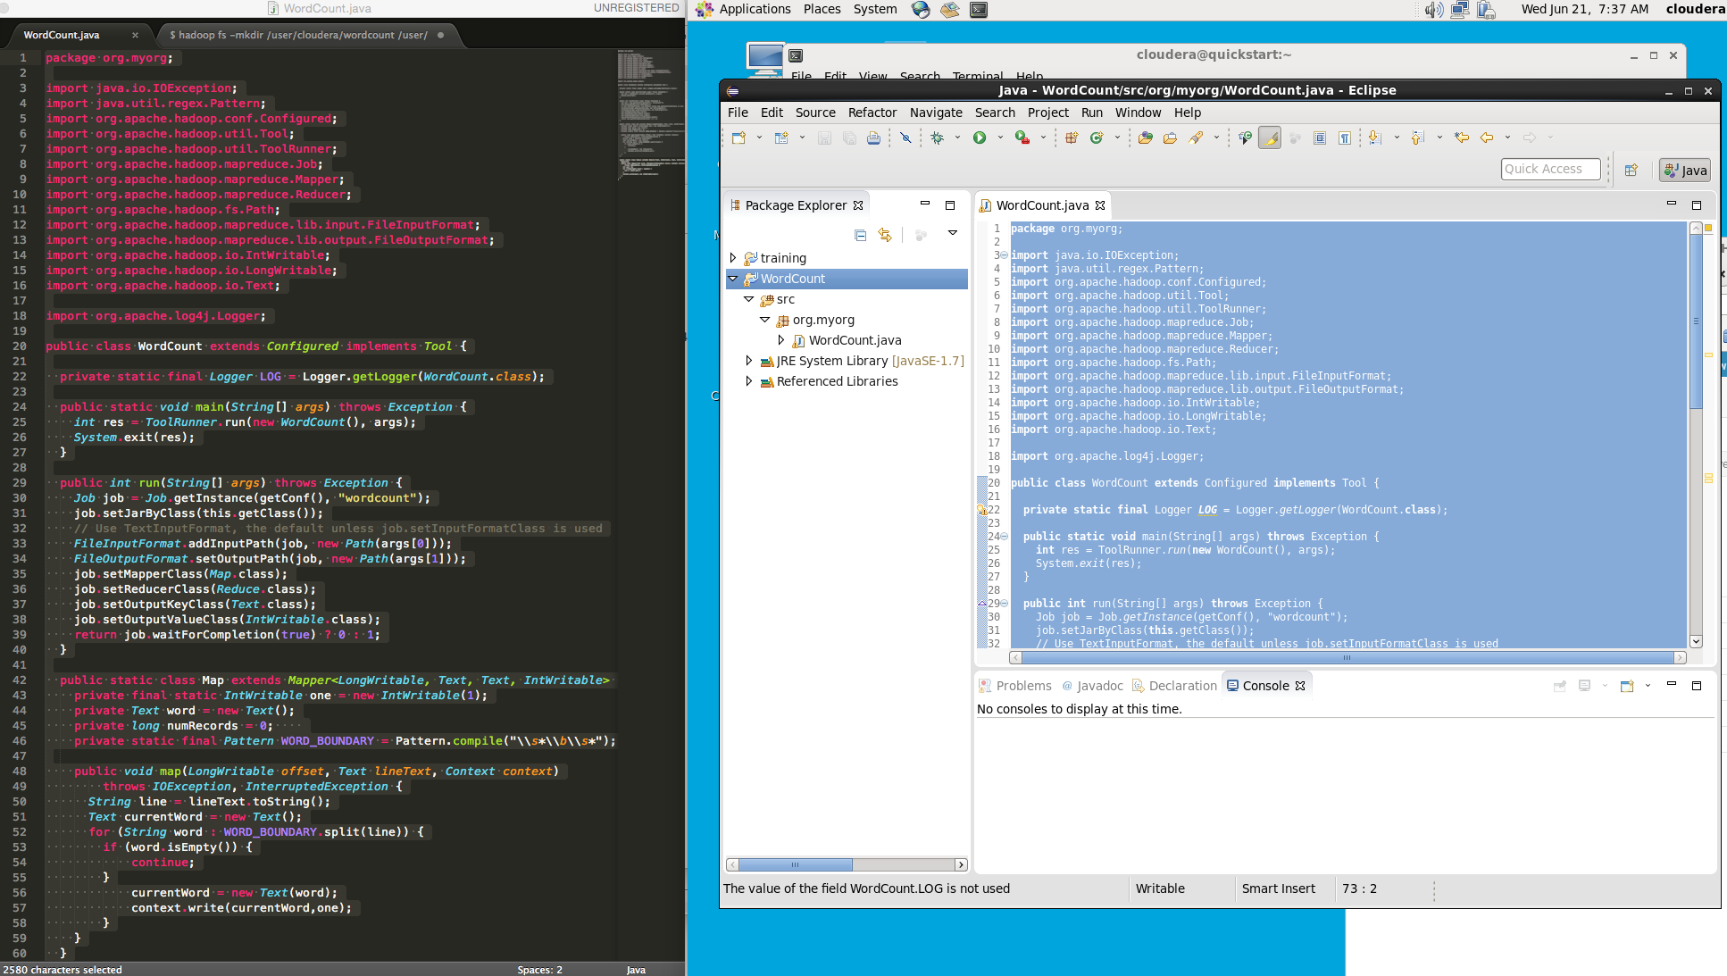
Paste WordCount.java (course directory) into your project WordCount.java, Save your file, should compile cleanly

Slide 13
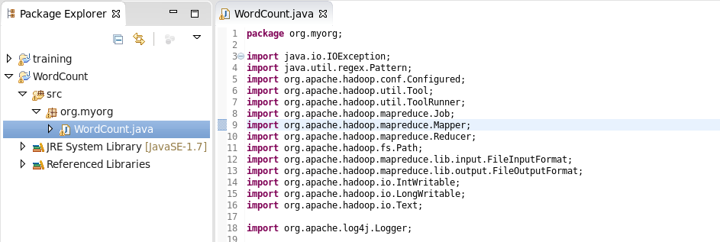
Code review – WordCount.java Note: org.hadoop.mapreduce.* -> MRv2
WordCount maps (extracts) words from an input source and reduces (aggregates) the results, returning a count of each word.
The version of WordCount in this tutorial are implemented to take advantage of the features in the MRv2 API.

Slide 14
Packages
Standard Java classes: IOException and regex.Pattern.
Use regex.Pattern to extract words from input files.
import java.io.IOException;
import java.util.regex.Pattern;
This application extends the class Configured, and implements the Tool utility class.
You tell Hadoop what it needs to know to run your program in a configuration object.
Then, you use ToolRunner to run your MapReduce application.
import org.apache.hadoop.conf.Configured;
import org.apache.hadoop.util.Tool;
import org.apache.hadoop.util.ToolRunner;
The Logger class sends debugging messages from inside the mapper and reducer classes.
Messages you pass to Logger are displayed in the map or reduce logs for the job on your Hadoop server.
import org.apache.log4j.Logger;

Slide 15
Packages continued
Use the Job class to create, configure, and run an instance of your MapReduce application.
Extend the Mapper class with your own Mapclass and add your own processing instructions.
Same is true for the Reducer: extend it to create and customize your own Reduce class.
import org.apache.hadoop.mapreduce.Job;
import org.apache.hadoop.mapreduce.Mapper;
import org.apache.hadoop.mapreduce.Reducer;
Use the Path class to access files in HDFS.
Pass the required paths using the FileInputFormat and FileOutputFormat classes.
import org.apache.hadoop.fs.Path;
import org.apache.hadoop.mapreduce.lib.input.FileInputFormat;
import org.apache.hadoop.mapreduce.lib.output.FileOutputFormat;
Writable objects have methods for writing, reading, and comparing values during map and reduce processing.
Think of the Text class as StringWritable.
import org.apache.hadoop.io.IntWritable;
import org.apache.hadoop.io.LongWritable;
import org.apache.hadoop.io.Text;

Slide 16
WordCount class, Run method
WordCount includes main and run methods, and the inner classes Map and Reduce. The class begins by initializing the logger.
public class WordCount extends Configured implements Tool {
private static final Logger LOG = Logger.getLogger(WordCount.class);
The main method invokes ToolRunner, which creates and runs a new instance of WordCount, passing the command line arguments.
When the application is finished, it returns an integer value for the status.
public static void main(String[] args) throws Exception {
int res = ToolRunner.run(new WordCount(), args);
System.exit(res);
}
The run method configures the job, starts the job, waits for the job to complete.
public int run(String[] args) throws Exception {
Create a new instance of the Job object. This example uses the Configured.getConf() method to get the configuration object for this instance of WordCount, and names the job object wordcount. Default config.
Job job = Job.getInstance(getConf(), "wordcount");

Slide 17
Run method continued
Set the JAR to use, based on the class in use.
job.setJarByClass(this.getClass());
Set the input and output paths for your application. You store your input files in HDFS, and then pass the input and output paths as command-line arguments at runtime.
FileInputFormat.addInputPaths(job, new Path(args[0]));
FileOutputFormat.setOutputPath(job, new Path(args[1]));
Set the map class and reduce class for the job. In this case, use the Map and Reduce inner classes defined in this class.
job.setMapperClass(Map.class);
job.setReducerClass(Reduce.class);
Set the output key and the value.
job.setOutputKeyClass(Text.class);
job.setOutputValueClass(IntWritable.class);
Launch the job and wait for it to finish. The method syntax iswaitForCompletion(boolean verbose). When true, the method reports its progress as the Map and Reduce classes run. When false, the method reports progress up to, but not including, the Map and Reduce processes.
return job.waitForCompletion(true) ? 0 : 1;
}

Slide 18
Mapper
The Map class transforms key/value input into intermediate key/value pairs to be sent to the Reducer.
public static class Map extends Mapper<LongWritable, Text, Text, IntWritable> {
private final static IntWritable one = new IntWritable(1);
private Text word = new Text();
Regular expression pattern to parse each line of input text on word boundaries ("\b").
private static final Pattern WORD_BOUNDARY = Pattern.compile("\\s*\\b\\s*");
Hadoop invokes the map method once for every key/value pair from your input source.
This does not necessarily correspond to the intermediate key/value pairs output to the reducer.
In this case, the map method receives the offset of the first character in the current line of input as the key, and a Text object representing an entire line of text from the input file.
public void map(LongWritable offset, Text lineText, Context context)
throws IOException, InterruptedException {

Slide 19
Mapper
Convert the Text object to a string. Create the currentWord variable, which isused to capture individual words from each input string.
String line = lineText.toString();
Text currentWord = new Text();
Use the regular expression pattern to split the line into individual words.
for ( String word : WORD_BOUNDARY.split(line)) {
if (word.isEmpty()) {
continue;
}
currentWord = new Text(word);
context.write(currentWord,one);
}
}

Slide 20
Reducer
The mapper creates a key/value pair for each word, composed of the word and the IntWritable value 1.
The reducer processes each pair, adding one to the count for the current word.
It then writes the result for that word to the reducer context object.
When all of the intermediate key/value pairs are processed, the map/reduce task is complete. The application saves the results to the output location in HDFS.
public static class Reduce extends Reducer<Text, IntWritable, Text, IntWritable> {
@Override public void reduce(Text word, Iterable<IntWritable> counts, Context context)
throws IOException, InterruptedException {
int sum = 0;
for (IntWritable count : counts) {
sum += count.get();
}
context.write(word, new IntWritable(sum));
}
}
}

Slide 21
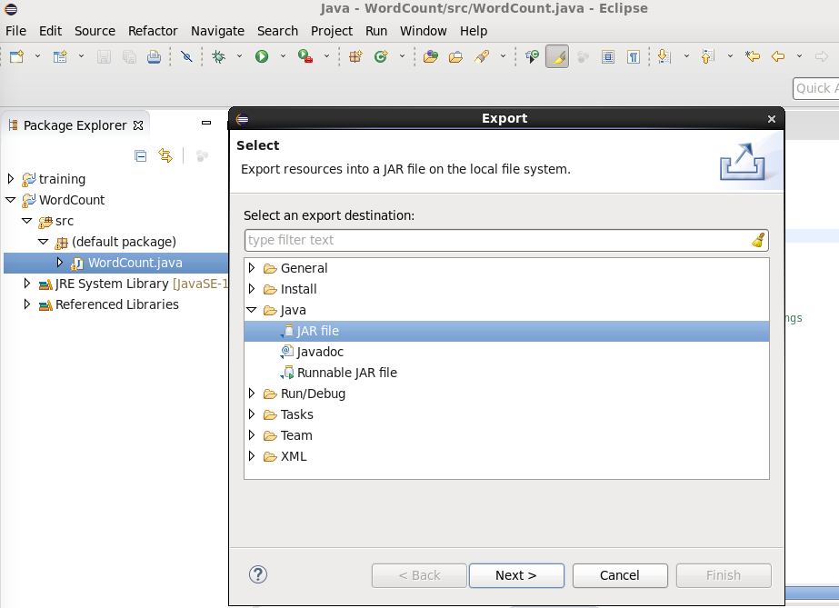
Export jar

Slide 22
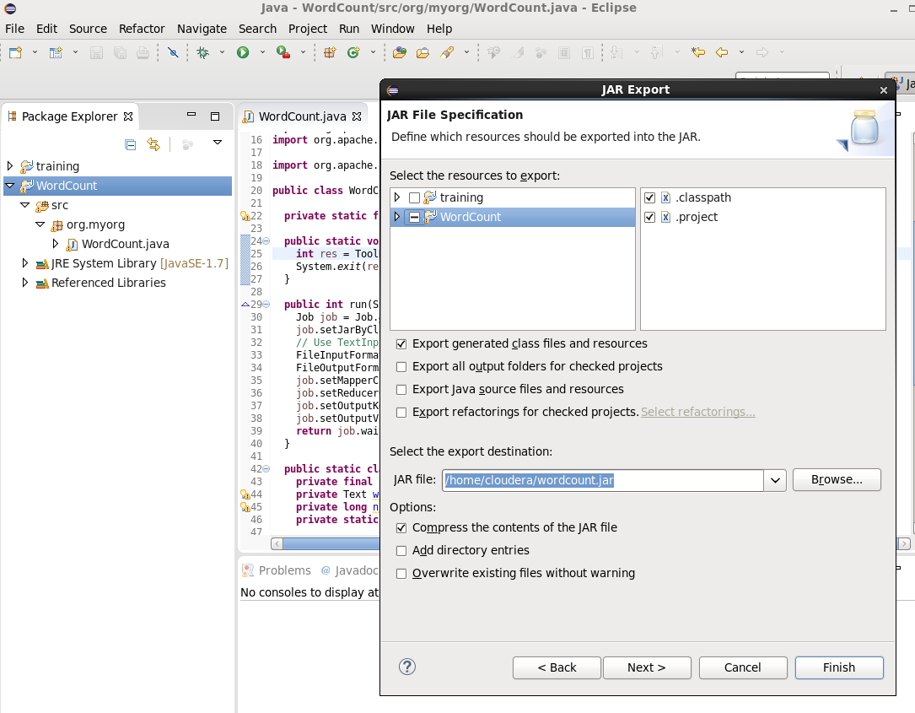
Export jar

Slide 23
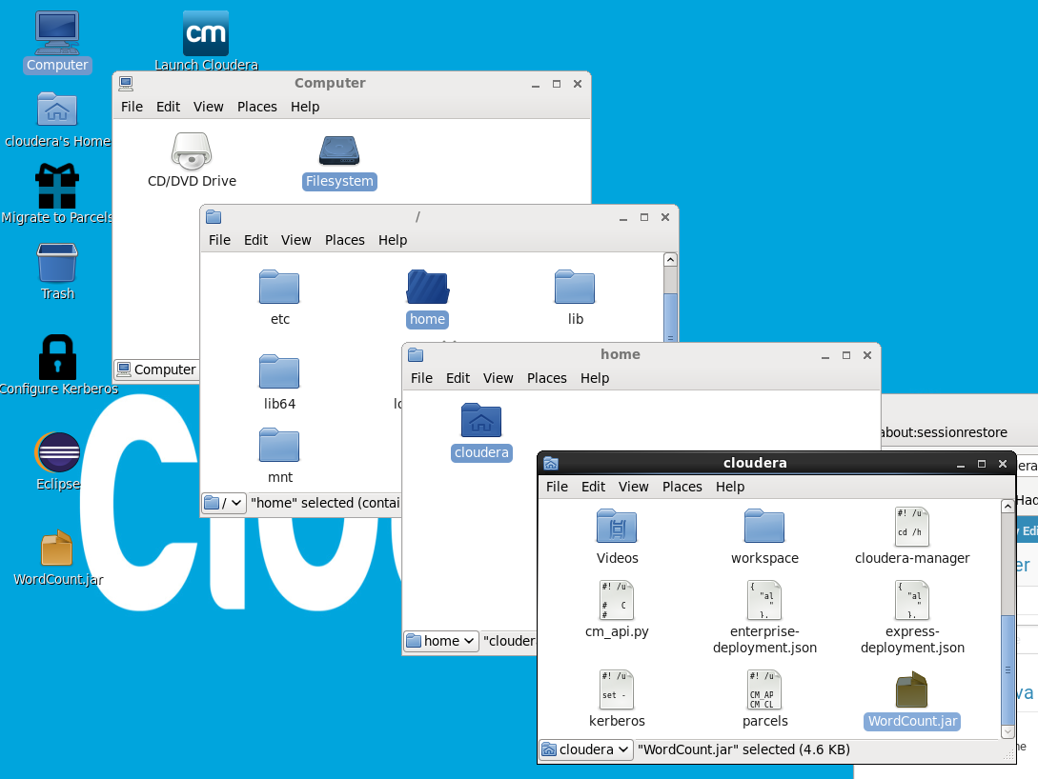
Export jar – Note: I renamed the jar file wordcount.jar

Slide 24
Create some data to process
﻿﻿From the terminal:
create an input directory,
create input files for processing, and
move the input files into HDFS:
﻿﻿$ hadoop fs -mkdir /user/cloudera/wordcount /user/cloudera/wordcount/input
$ echo "Jay Urbain" > file0
$ echo "Kimberly Urbain" > file1
$ echo "Jenna Urbain Hoelz > file2
$ echo "Jenna Urbain Hoelz" > file2
$ echo "Lauren Urbain Haehle" > file3
$ echo "Lucas Urbain" > file4
$ echo "Emmerson Hoelz" > file5
$ hadoop fs -put file* /user/cloudera/input

Slide 25
Execute your Hadoop job
﻿$ hadoop jar wordcount.jar org.myorg.WordCount /user/cloudera/wordcount/input /user/cloudera/wordcount/output
Lots of output, watchfor exceptions, some are benign:
17/06/21 06:40:40 INFO client.RMProxy: Connecting to ResourceManager at /0.0.0.0:803217/06/21 06:40:41 INFO input.FileInputFormat: Total input paths to process : 7 ….
﻿
Note: you output directory /user/cloudera/wordcount/output can not exist. If it does, or you want to rerun your job, you can remove it and its contents as follows:
$ hadoop fs -rmdir /user/cloudera/wordcount/output

Slide 26
Verify output
﻿$ hadoop fs -cat /user/cloudera/wordcount/output/*
Carter 1
Emmerson 1
Haehle 2
Hoelz 2
Jay 1
Jenna 1
Kimberly 1
Lauren 1
Lucas 1
Urbain 5

Slide 27
Design Patterns
On your own

Slide 28
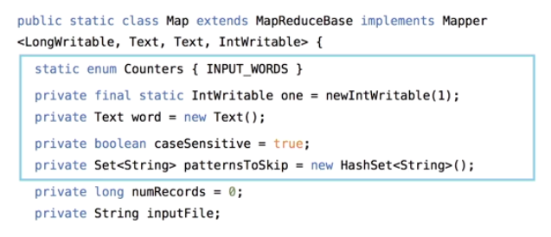
Adding Variables for Monitoring

Slide 29
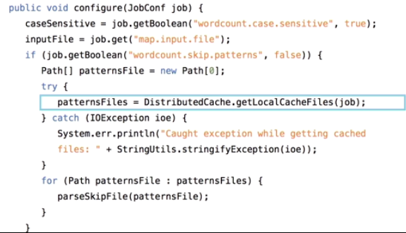
Distributed Cache

Slide 30
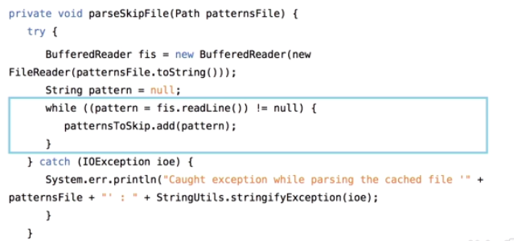
Optimization: Skipping Files

Slide 31
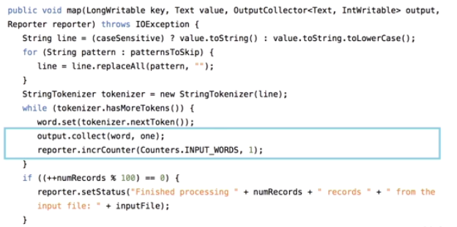
Mapper with Counter

Slide 32
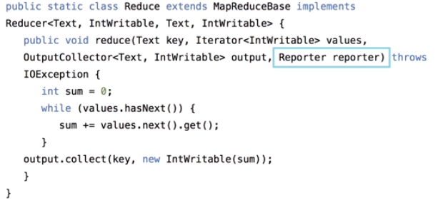
Reducer with Reporter

Slide 33
Review
Which of the following features of MapReduce 2.0 is very interesting and ausing a lot of people to be excited about?
Splitting the existing JobTracker’s role
Batch or interactive processing
Adding enterprise features
Supporting many frameworks
How do you add references to Hadoop libraries in your project using Eclipse
Right-click on project -> Properties -> Add External jars -> bin -> lib
Right-click on project -> Properties -> Add External jars -> File System -> lib
Right-click on project -> Properties -> Add External jars -> Documents-> usr -> lib
Right-click on project -> Properties -> Add External jars -> File System -> usr -> lib
Which of the following will allow you to add a variable for monitoring MapReduce 2.0?
Private Text
static enum Counters {INPUT_WORDS}
None of these
Private caseSensitive=true;

